Slide 1


CORONA VIRUS ANALYSIS WITH SQL

Slide 2
PROJECT OVERVIEW
The COVID-19 pandemic has had a profound impact on global public health, underscoring the need for data-driven insights to understand the virus's spread.
This analysis of the CORONA VIRUS dataset aims to help healthcare professionals derive meaningful insights into the virus's global spread and improve emergency response strategies for future pandemics.

Slide 3
METHODOLOGY/APPROACH
Data Acquisition : The CORONA VIRUS dataset was imported into a Jupyter notebook.
Data Cleaning: Data cleaning and preprocessing were conducted to ensure the accuracy and reliability of the analysis results.
Analytical Tools: Analysis was conducted using Structured Query Language (SQL).
Visualization: Key findings were visualized to enhance understanding and communication of the data insights.

Slide 4
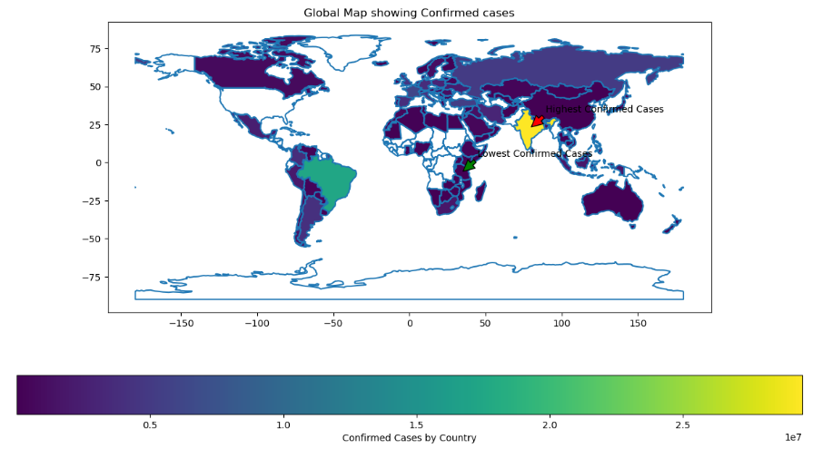
GLOBAL SPREAD & CASE DISTRIBUTION

Slide 5
KEY NOTE
Visualization Details:
Map showing confirmed cases across 121 countries.
Highlighted areas with the highest and lowest number of cases.
Key Insights:
The US has the highest number of confirmed cases (33,461,982)
Kiribati reported the lowest number of confirmed cases (2 cases)

Slide 6
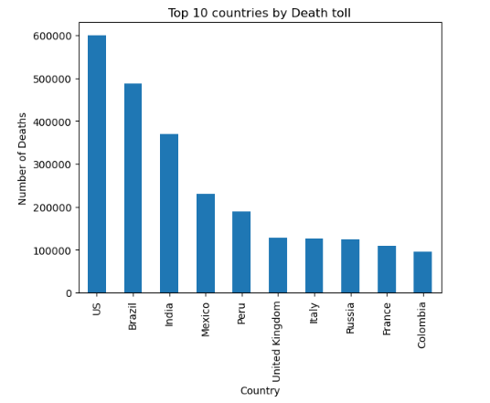
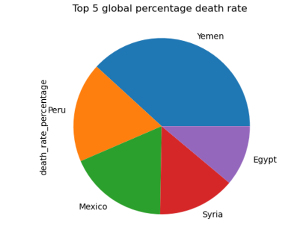
DEATH & MORTALITY RATE

Slide 7
KEY NOTE
Visualization Details:
Bar chart comparing death tolls in different countries.
Pie chart showing the global death rate percentage.
Key Insights:
The US has the highest number of deaths (599,769).
The global death rate stands at 2.1% of confirmed cases.

Slide 8
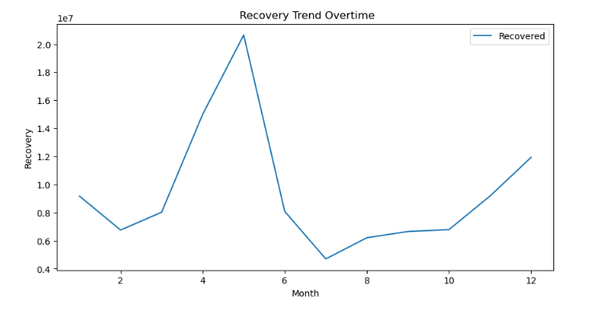
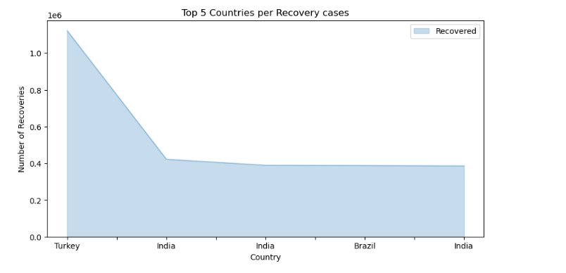
RECOVERIES

Slide 9
KEY NOTE
Visualization Details:
Line graph showing the recovery trends over time.
Comparative analysis of recoveries in the top 5 countries: India, Brazil, US, Turkey, and Russia.
Key Insights:
The total number of recoveries globally is 113,089,548.
India, Brazil, the US, Turkey, and Russia have the highest number of recoveries.

Slide 10
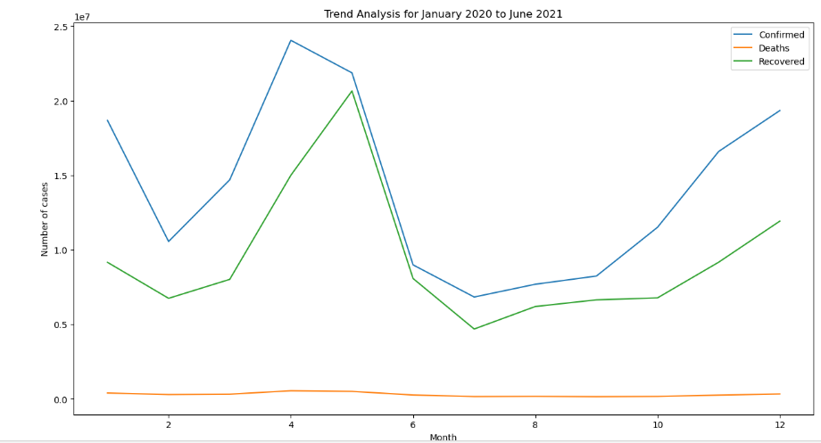
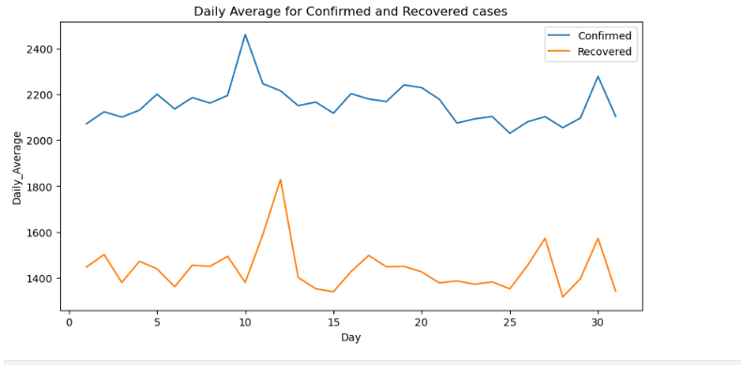
DAILY AVERAGE & TRENDS

Slide 11
KEY NOTE
Visualization Details:
Daily averages of confirmed cases and recoveries.
Trend analysis over the 18-month period from January 22, 2020, to June 13, 2021.
Key Insights:
Average of 2,157 confirmed cases per day.
Average of 1,443 recoveries per day.

Slide 12
REPORT/FINDINGS
Global Insights
Confirmed Cases:
Total: 169,065,144
Average: 2,157 cases/day
Deaths:
Total: 3,647,894
Average: 47 deaths/day
Recoveries:
Total: 113,089,548
Average: 1,443 recoveries/day

Slide 13
REPORT/FINDINGS
Country-Specific Insights
United States: Highest number of confirmed cases and deaths.
India, Brazil, Turkey, Russia: Significant number of recoveries, indicating effective treatment protocols.
Nigeria: Notable for its 1% death rate and 99% recovery rate from 167,066 confirmed cases.

Slide 14
CONCLUSION
This analysis provides valuable insights into the spread and impact of COVID-19 globally.
By leveraging SQL and data visualization techniques, we can better understand the trends and outcomes associated with the pandemic, aiding in more effective public health responses and preparedness for future pandemics.

Slide 15
NEXT STEPS
To do further analysis on vaccination rates and their impact on case and death rates.
Conduct longitudinal studies on the socio-economic impact of the pandemic.
To enhanced data collection methods for more granular insights.

